Slide 1

BASKETBALL
METRICS
BTMA 431
Wei Huang, Akansha Malik, Ana-Maria Peric, Weize Sun
Notes:
Hello, My name is Jack and I am joined by Wei, Akansha, and Ana. Our presentation and analysis today will be about basketball metrics. Specifically, NBA Metrics.

Slide 2
TABLE OF CONTENTS
01
02
03
OVERVIEW
Introduction, Motivation, Context
DATA SOURCES
Data Collection Process
FINDINGS
Importance
Notes:
Our agenda today includes a brief overview of our motivations and context, a description of our data collection process and sources, and finally, our findings.

Slide 3
OVERVIEW
01
Introduction, Motivation, Context

Slide 4
INTRODUCTION
In this presentation, we dive into multiple metrics within the 2022-2023 NBA season and compare their values with the previous season
Notes:
In this presentation, we dive into multiple metrics within the 2022-2023 NBA season, including average points scored as well as injuries, comparing their values with the previous season. We’ll also explore advanced stats to find out which values have the biggest effect on their overall value.

Slide 5
MOTIVATION
Parlays (bets) are not hitting like they used to
General love for the sport
Readily Available Data
Notes:
One of the reasons we chose to use NBA statistics is because my parlays have not been hitting. Coming from a broke uni student, I’m hoping the data we present here today will help fund my next ubereats order.
Another reason is my general love for basketball. Basketball was the first sport that I heavily invested in, be it time, money, or grades. To be able to combine basketball with analytics is also one of the reasons I chose to major in this field.
And finally, the NBA, as well as most major sports associations, heavily invest in analytics and data to stay competitive within their respective leagues. Having access to data this extensive gave us the opportunity to explore different comparisons and regression models.

Slide 6
WHO WOULD BENEFIT?
SCOUTS & COACHES
crucial for scouting and drafting players
PLAYERS
improved performance analysis and injury prevention
FANS
Avid fans and sports betters alike
Notes:
So Who would benefit from this analysis?
Firstly, fans would benefit, whether it be avid basketball fans recruiting players for their fantasy team, or sports betters like myself trying to pay for next month's rent.
Players can also benefit from this by using it to track performance analytics for themselves and for their teammates or opponents. They can also use this to help with injury prevention
Scouts and coaches also benefit from this because analytics is crucial for scouting and drafting players, coaches can also use this data to help draw plays for their players of against opponents

Slide 7
RESEARCH QUESTIONS
SCORING TOTAL
INJURY STATISTICS
Comparisons between the 2022 and 2023 season
Top 10 injury types comparisons between the 2022 and 2023 season
WIN SHARE PREDICTOR
What stats accurately predict this metric?
Notes:
Our research questions include Scoring Total, which compares the averages of total scoring between the 2022 and 2023 season, Injury Statistics which compares the top 10 injuries between the two seasons, and finally we researched win share predictor to accurately predict which stats affect this metric the most. I will now pass it off to Akansha to talk about or data collection process

Slide 8
DATA SOURCES
02
Data Collection Process
Notes:
Thank you Jack!
I will be going over our data sources and collection process!

Slide 9


DATA SOURCES
NBAloveR
Question 1
Question 2
Question 3
NBAloveR Package API
NBA Injury Database
Basketball Reference
Notes:
Thank you Jack!
These are our data sources for our project.
Question 1 uses NBAloveR package in R Studio, which provides an interface to access basketball data using APIs
Question 2 utilizes HashTag BasketBall’s NBA injury database, a fantasy basketball fansite
Finally: Question 3 uses Basketball reference, which is a website that records and blogs related stats

Slide 10
DATA COLLECTION PROCESS
NBAloveR
Question 1
Question 2
Question 3
NBAloveR Package API
Utilize the package function ‘getMatchUps()’
NBA Injury Database
Form an HTTP GET request to the web server
Extract data from the server’s response
Basketball Reference
Read the HTML of the webpage
Extract data from the tables
Notes:
Question 1:
getMatchUps() allows you to obtain game specific data by specifying a team and season as input parameters. We would make repeated calls with this function for all teams within the NBA and for the specified seasons.
Question 2:
We form an HTTP GET request to the web server, parse through the HTML (in the response), and extract data from the tables
Question 3:
Instead of using a GET request, we utilize rvest() package to call the read_html() function with the specified URL to extract data from the tables.
I will now hand it over to Jack to discuss our first primary question!
NBA Injury Database
Data collection:
Top 10 injury types
Player data (days missed)
For injuries in the 2022-2023 and 2021-2022 seasons
Data collection:
Home team scores
Opponent team scores
For games in the 2022-2023 and 2021-2022 seasons

Slide 11
FINDINGS
03
Importance & Implications

Slide 12
PRIMARY QUESTION 1
Is there a statistically significant difference in the average scores of all NBA teams combined between the 2022 and 2023 seasons?
H0: avg2022 = avg2023
STEP 1
Capture relevant data from NBALoveR
STEP 2
Calculate the average score for each team
STEP 3
Perform a T.test on the two averages
Notes:
Thanks Akansha,
Our first primary question is. Is there a statistically significant difference in the average scores of all NBA teams combined between the 2022 and 2023 seasons? With our null hypothesis being that the average score between the two seasons is equal.
Our first step was to capture all relevant data from NBALoveR, as Akansha stated we used the getMatchups() function to retrieve game data for each team in the NBA, we then calculated the average score for each team and stored that value in a vector. Finally we performed a t.test on the two averages from the 2022 and 2023 season.

Slide 13
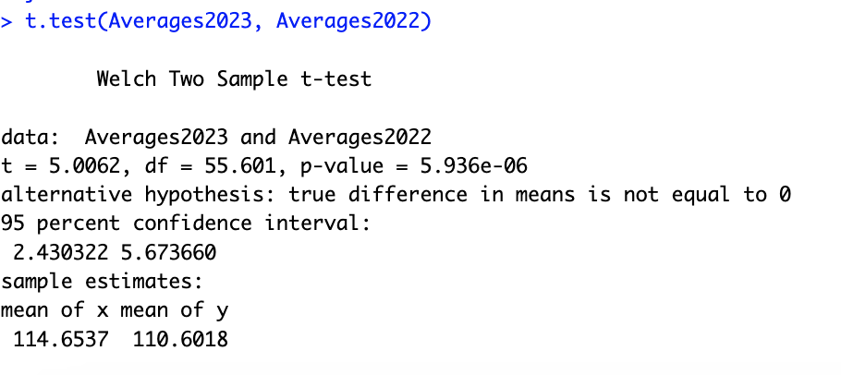
T.TEST RESULTS
P-value less than 0.05, therefore we reject the null hypothesis
Notes:
Our t.test results show that the mean of x and y is 114 and 110 respectively. X being 2023 averages and Y being 2022. Looking at the p.value, we see that it is less than 0.05, therefore we reject the null hypothesis. Which means that there is a statistically significant difference between the scoring averages in the two seasons.

Slide 14
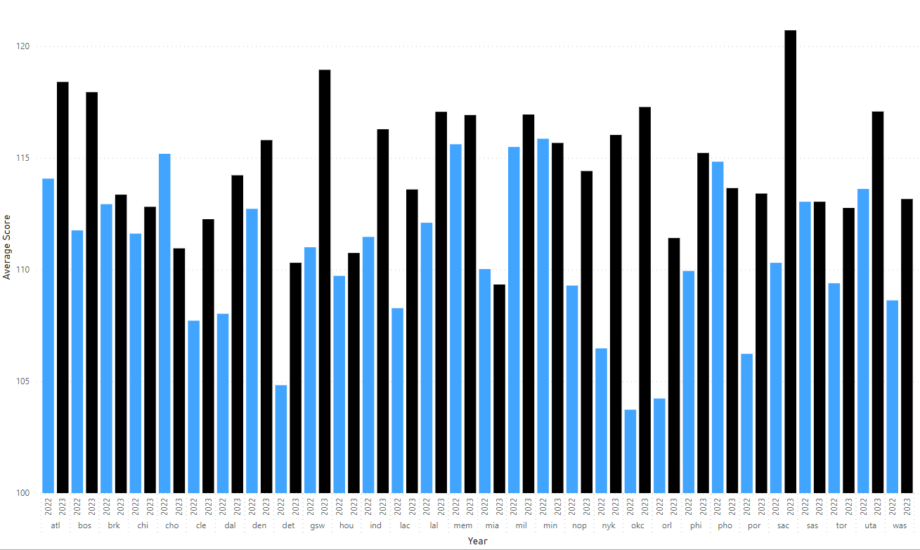
AVERAGE SCORE BY TEAM AND YEAR
Notes:
In the graph shown here we can clearly see why there is a difference between the two season. we see that the 2023 season, illustrated with the black bars, is generally higher than the 2022 season in blue across the board.

Slide 15
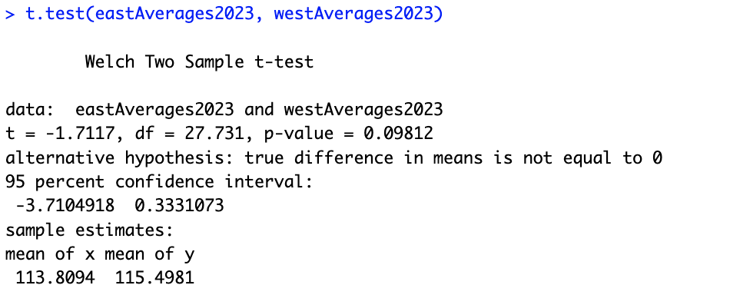
FOLLOW UP QUESTION 1
As there is a significant difference in the average between the two seasons, is there significant difference in the average between the east and west conference in 2023?
H0: avgWest2023 = avgEast2023
Notes:
For our follow up question we asked the following: As there is a significant difference in the average between the two seasons, is there significant difference in the average between the east and west conference in 2023?
With our null hypothesis being that the average West 2023 scores is equal to the average in the East
Looking at the resulting t.test below. We see that the mean of x and y are relatively close this time around. The resulting p-value is greater than 0.05 meaning we fail to reject the null hypothesis so there is no significant different in the average scoring between the two conferences.

Slide 16
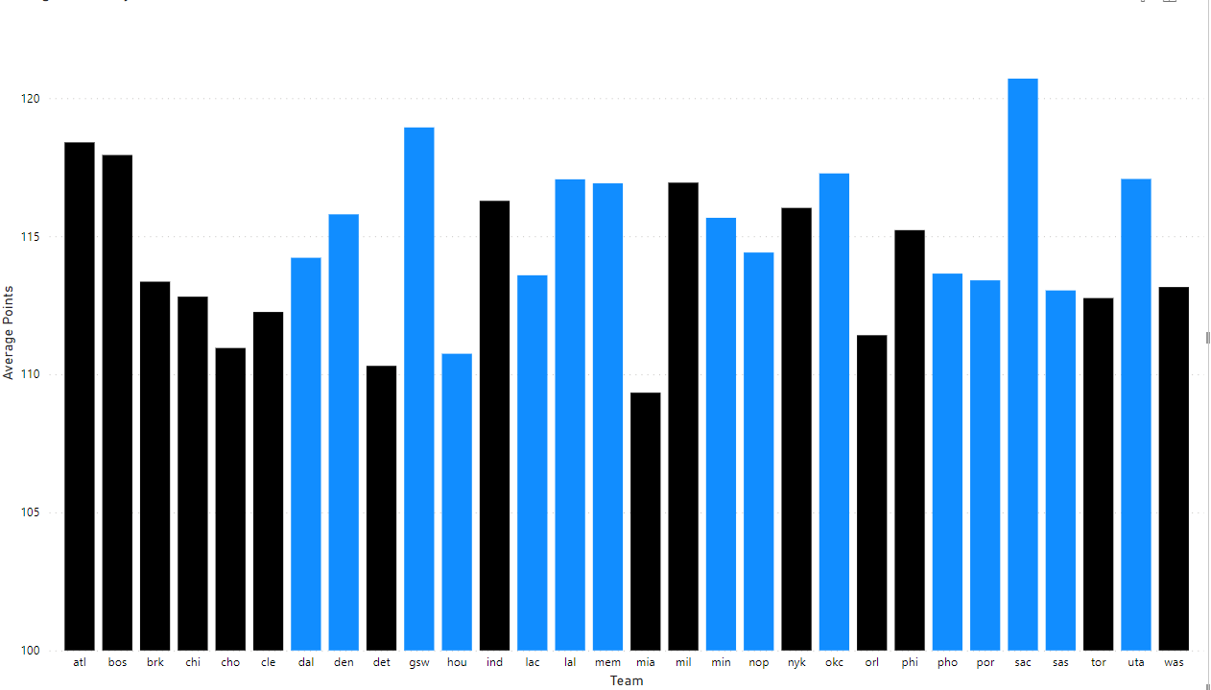
AVERAGE SCORE BY TEAM AND YEAR
Notes:
This is illustrated in the graph shown, we see that the values for the eastern conference (in black) is generally similar to the western conference (in blue). I will now pass it off to Wei to present Primary question 2

Slide 17
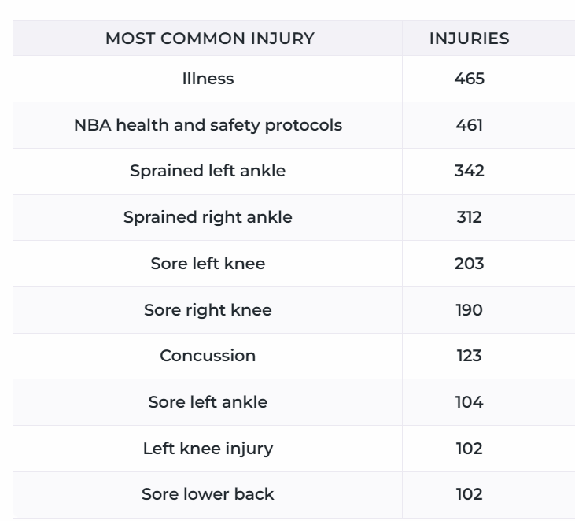
PRIMARY QUESTION 2
Primary Question:
Is there a statistically significant difference in the top 10 average types of injuries for all teams in the NBA.
Follow Up Question:
Is there a statistically significant difference in the top 10 average types of injuries for different teams in the NBA.
Compare 2021-2022 season and 2022-2023 season.
Notes:
Thanks jack,
For question 2. We will use t.test to examine is there a statistically significant difference in the top 10 average types of injuries for all teams in the NBA.
After this question, we will test the data that shows the difference in the top 10 average types of injuries for different teams. All the time range is 2021-2022 season and 2022-2023 season.
The ten types of injuries listed here represent the main health issues that NBA players deal with. The physical health of players is addressed by concussion and health and safety. The damages to particular body parts are involved in both the illness and left knee injury. Extended periods of physical activity may cause sore lower back and left ankle. Sprained left and right ankles are frequent sports injuries. The various physical stresses and difficulties that players face during games result in these injury types.

Slide 18
PRIMARY HYPOTHESIS
H0:
H1:
The average days missed due to the top 10 injury types in the 2021 - 2022 season are consistent with those in the 2022-2023 NBA season.
The average days missed due to the top 10 injury types in the 2021-2022 season differ from those in the 2022-2023 NBA season.
Notes:
Here is our hypothesis for question 2. Our zero Hypothesis is ‘The average days missed due to the top 10 injury types in the first season are same with those in the second NBA season’.the alternative hypothesis is ‘The average days missed due to the top 10 injury types in the first season are different with those in the second NBA season’.

Slide 19
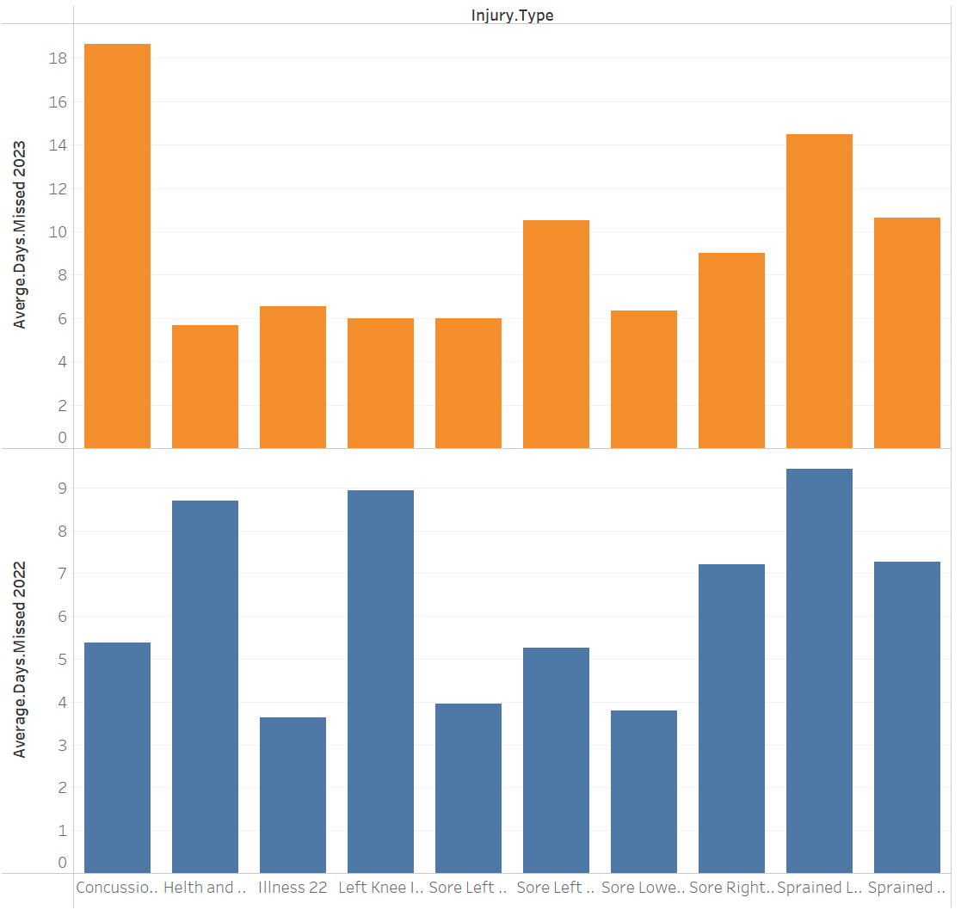
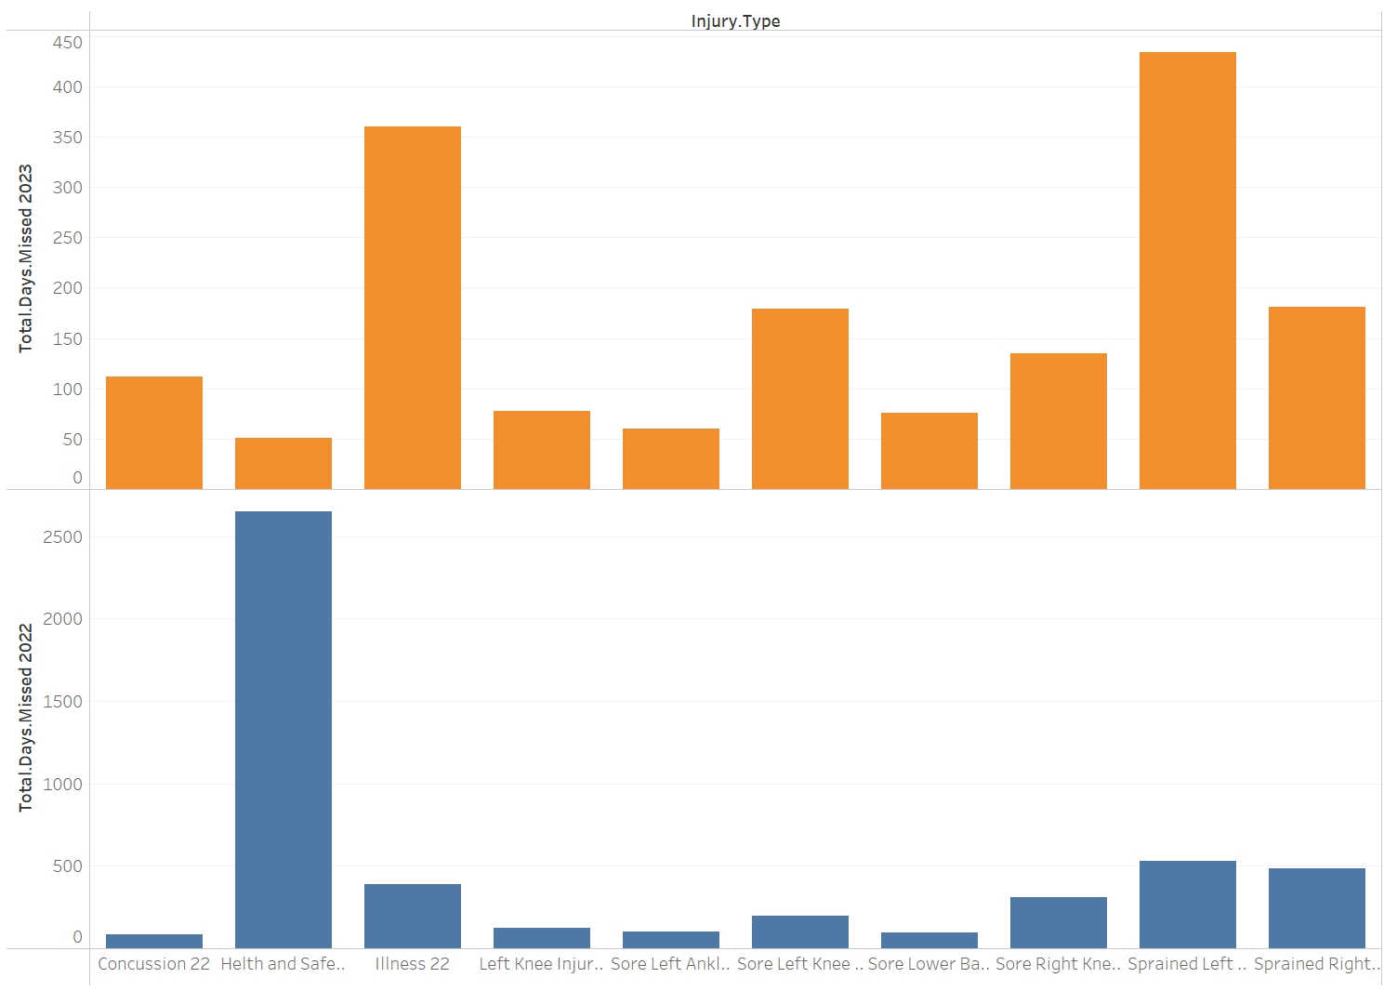
Average Missed Days In Different Injury Type:
Total Missed Days In Different Injury Type:
Injury Types’ order: Concussion, Health and safety, Illness, Left knee injury, Sore left ankle,Sore lower back, Sore right ankle, Sprained left ankle, Sprained right ankle.
Notes:
There are two diagrams to show the difference. The yellow bars is 2023 season data, blue ons is 2022 seasons. Generally, no matter total missed days or average missed days the difference is not obvious except those extremely high value.

Slide 20
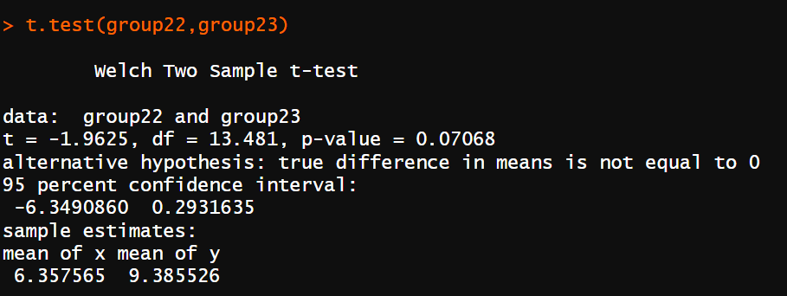
T.TEST RESULTS
P-Value = 0.07068
> 0.05
We do not have enough evidence to reject the H0.
The average days missed may be similar.
There are the other potential influencing factors on the experimental outcomes.
Different teams may have different injury treatments.
Notes:
To comparing the average days missed for the same injury types in two different NBA seasons, we found a p-value greater than .05. Consequently, we do not have enough evidence to reject the zero hypothesis, it present that the average days missed for these injury types may be similar between the two seasons. We lack enough evidence to support the statement that the same injury types have an impact on days missed across different seasons. Different teams' different approaches to treating injuries may have an impact on the experimental results.

Slide 21
FOLLOW UP HYPOTHESIS
H0:
H1:
The average days missed due to the top 10 injury types for different teams in 2021-2022 season are similar with all teams in the 2022-2023 season.
The average days missed due to the top 10 injury types for different teams in the 2021 - 2022 season are different from those for all teams in the 2022-2023 seasons.
Notes:
so, here is our hypothesis for follow up question 2. Our zero Hypothesis is ‘The average days missed due to the top 10 injury types for different teams in first season are similar with those in the second season’.the alternative hypothesis is ‘The average days missed due to the top 10 injury types for different teams in the first season are different from those in the second seasons.’.

Slide 22
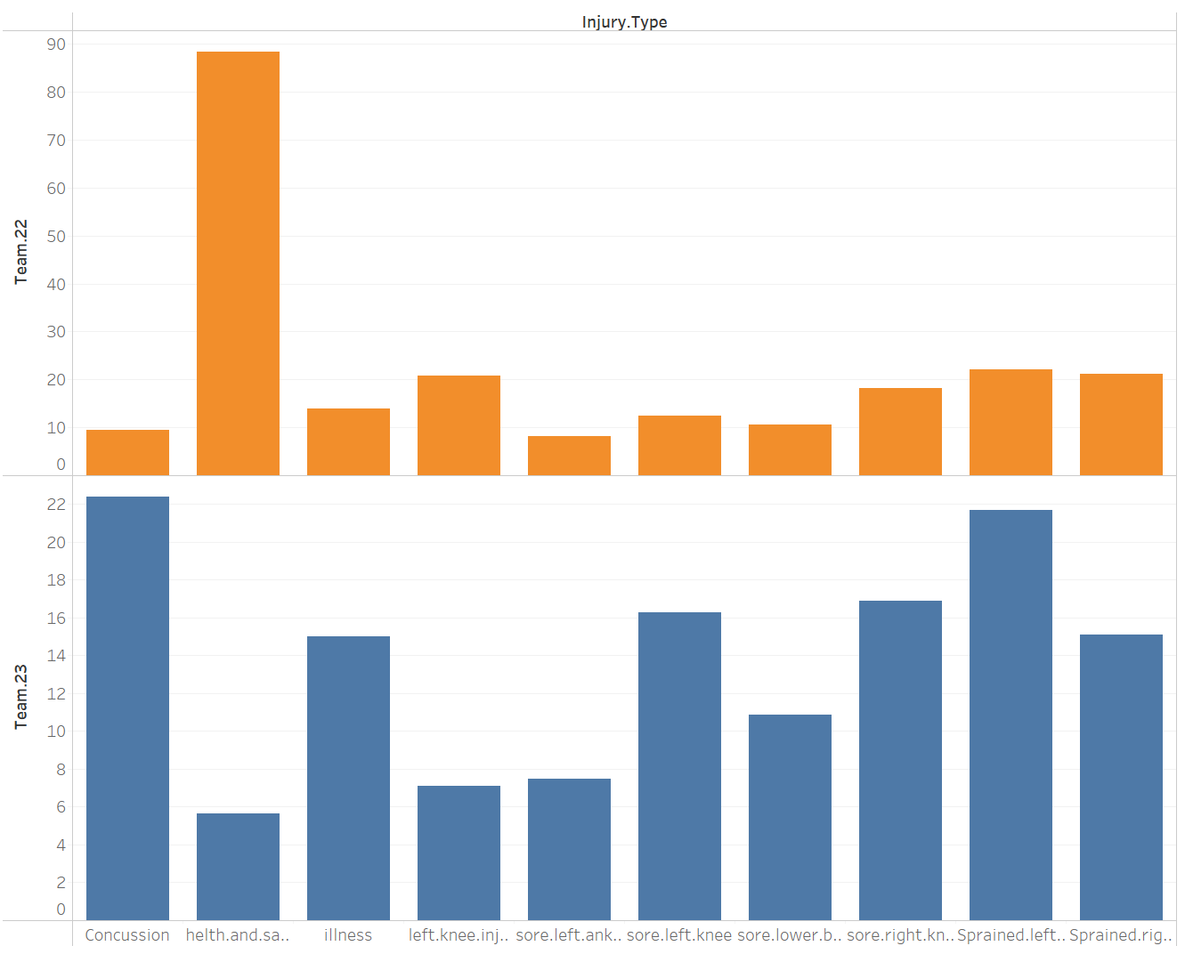
The average day missed of different teams of different injury types in 2 seasons:
Injury Types’ order: Concussion, Health and safety, Illness, Left knee injury, Sore left ankle,Sore lower back, Sore right ankle, Sprained left ankle, Sprained right ankle.
Notes:
This is a diagram shows the average day missed of different injury types in 2 seasons, group by teams. As we can see. The average day missed in 2023 season is higher than 2022 season.

Slide 23
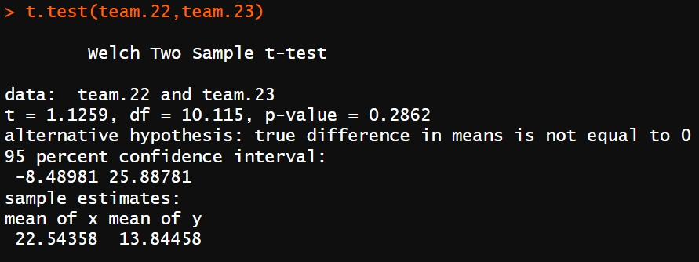
T.TEST RESULTS
P-Value = 0.2862
> 0.05
We do not have enough evidence to reject the H0.
There is no significant difference of the average days missed in different teams.
There is not enough evidence to support that different teams have special therapy.
Notes:
Teams appear to experience a similar impact from these 10 injury types across both seasons. According to statistical analysis P value larger than .05, we do not have enough evidence to support significant differences in how different teams treat injuries, when it comes to affecting player absence. However, given the limitations of sample size and potential variables, a more detailed study may be required to comprehensively understand potential differences in treatment strategies of teams.
Let me pass to akansha to introduce question 3.

Slide 24
PRIMARY QUESTION 3
Which player statistic(s) can be a good predictor for a player’s win share?
Notes:
Our final primary question is: “Which player statistic(s) can be a good predictor for a player’s win share?

Slide 25
PLAYER STATISTICS
Statistics in basketball are recorded to evaluate a player's or a team's performance.
Examples of basic information
Player name, position, age, team
Advanced stats can consist of
Player efficiency rating, true shooting percentage %, free throw attempt, and Win Share
Notes:
To provide some context, statistics in basketball are recorded to evaluate a player’s or team’s performance. They are typically recorded per season and/or for overall, lifetime career.
In terms of player statistics, it can vary from basic information to more advanced stats!
Some examples of basic information are player name, position, age, team, games played, minutes played
More advanced statistics can consist of things like Player efficiency rating, true shooting percentage, free throw attempt, and win share

Slide 26
PLAYER STATISTICS - WIN SHARE
In the NBA, Win Shares are a well-known metric that aims to estimate the number of wins (successes) a player contributes to their team throughout a season.
Different types of Win Shares
Offensive
Defensive
Win Shares/48 minutes
Total Win Share: The sum of offensive and defensive win shares
Notes:
Win share is a popular metric in the NBA. It is an estimation of the number of wins a player contributes to their team throughout a season.
Win share can be measured and calculated in different ways. In particular, there are four types of win shares metrics, such as:
Offensive, which is an estimate of the number of wins by a player due to offence plays
Defensive, which is an estimate of the number of wins by a player due to defence plays
Win Shares/48 minutes, which is an estimate of the number of wins contributed by a player per 48 minutes
And finally, total win share! Which is the sum of offensive and defensive win shares
Thus, we wanted to investigate the total win shares, since it is an aggregate metric and captures both types of plays.

Slide 27
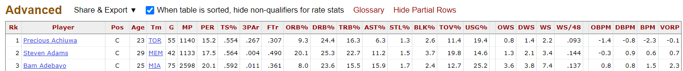
PLAYER STATISTICS - CONT’D
Basketball-reference keeps a record of many statistics per season, for example:
Can we use some of these statistics to predict a player’s Win Share?
Snippet from Basketball-reference
Notes:
Our data source, Basketball-reference keeps a record of many advanced statistics for players in a season
After coming across this data, we thought to ourselves “So.. is it possible to predict a player’s win share based on some of these advanced statistics? If so, which ones are the best predictors?”
There are a lot of acronyms and sports jargon, so the next slide will briefly summarize the stats we choose to include in our model!

Slide 28
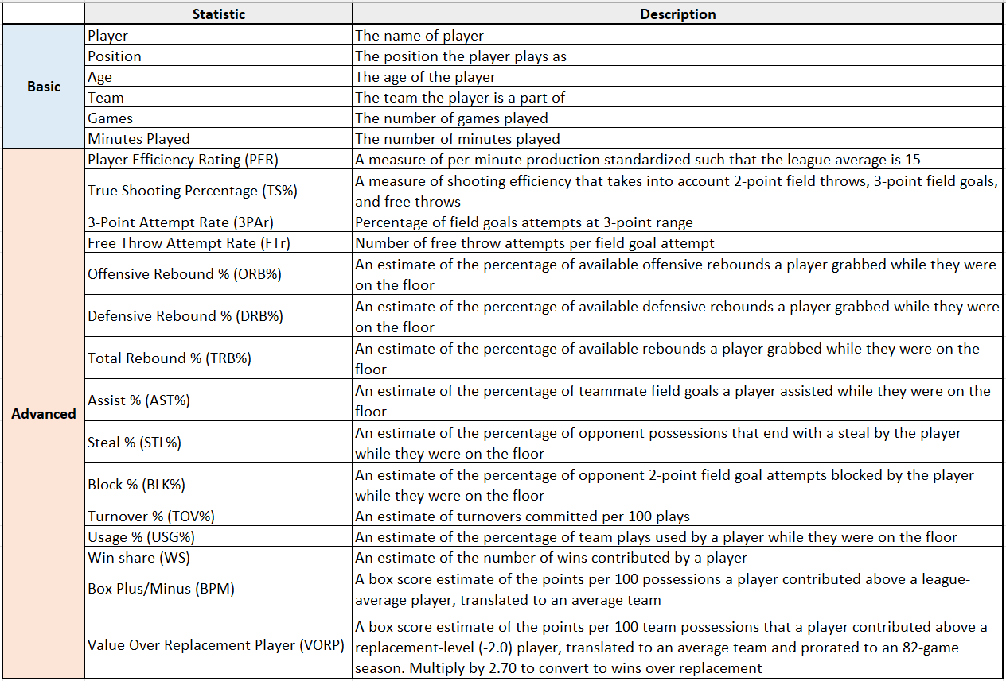
PLAYER STATISTICS OBTAINED
Notes:
These are the player statistics we obtained! I won’t read through all of them as it will take up time. But it contains a combination of basic and more advanced statistics. The advanced stats capture more of the player’s performance and actions in game.

Slide 29
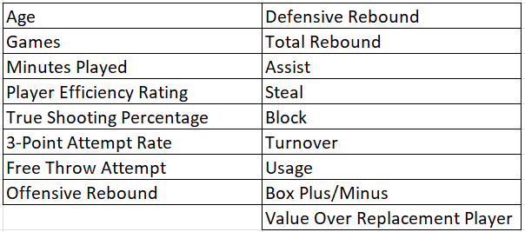
SETTING UP THE INITIAL MODEL
Removal of the qualitative/categorical stats (player name, team, etc) from our obtained data
Selected only the numerical stats to be a part of model
‘Model1’ predictors
Notes:
To set up our initial regression model, we decided to remove any qualitative and categorical stats and just focus on numerical values
Which left us with the stats in the table on the screen, totaling 17 predictors!

Slide 30
AFTER APPLYING VIF()...
We found that a few of the stats had values greater than five, which indicates signs of multicollinearity
Must refine our model further!
Applied stepVIF(), we removed two stats from our model!
Notes:
We felt confident in our first model since we only chose numerical values, however..
After applying the VIF() function, we noticed that a few stats had values greater than 5. Indicating multicollinearity!
We need to refine our model further
So, we applied stepVif() and removed two stats from our model: Offensive Rebound + Total Rebound
Applying VIF() again led us to still having some predictors with values greater than 5. We removed those and so far, our model, now called as model2, contained:
Age + `TrueShootingPercentage` + `3-PointAttemptRate` + `FreeThrowAttemptRate` + `DefensiveRebound` + `Assist` + `Steal` + `Block` + `Turnover` + `Usage` + `ValueOverReclacementPlayer (Down to 11 predictors)
To predict winshare!
I will pass off to Ana to discuss our regression diagnostics for our model, thus far!

Slide 31
REGRESSION DIAGNOSTICS
Errors Have a Mean of Zero
Errors are Normally Distributed
Errors are normally distributed with the peak around 0.
Using a qplot of the residuals and a Quantile-Quantile plot
Model Accuracy
AIC/BIC Selection Techniques
Checking for correlation between errors and predictors
Assess both AIC and BIC outputs
Notes:
With this newly refined model, we perform some diagnostic checks. These checks include ensuring that the errors have a mean of zero, they are normally distributed, and that there is no correlation between the errors and predictors. We checked if the errors were normally distributed by using a qplot to plot the residual values, and confirmed our results with the quantile-quantile plot. Lastly, we applied AIC and BIC selection techniques to even further optimize our model as best we could.

Slide 32
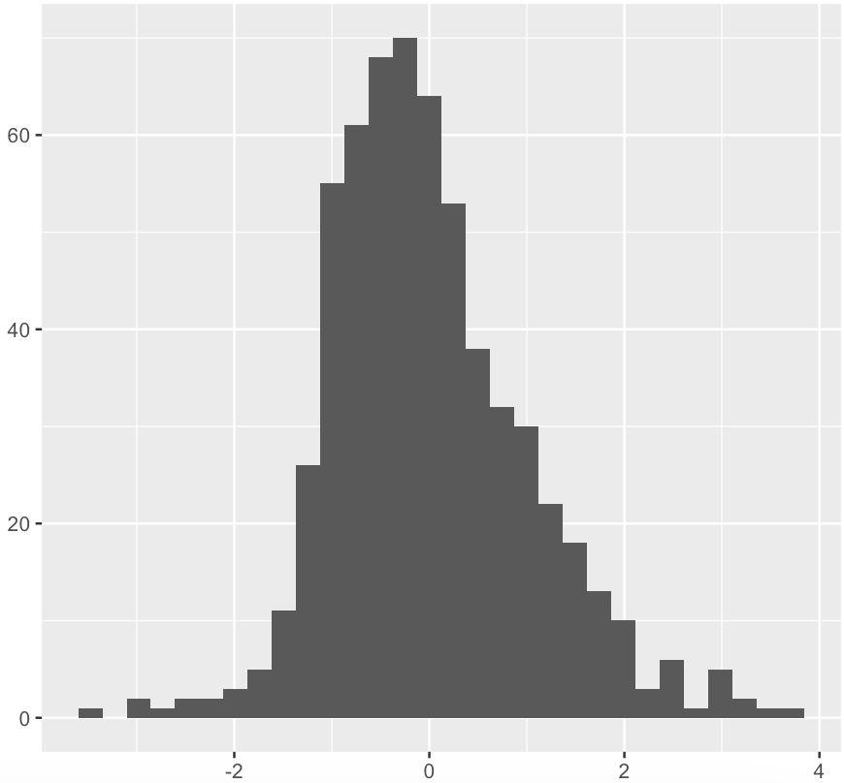
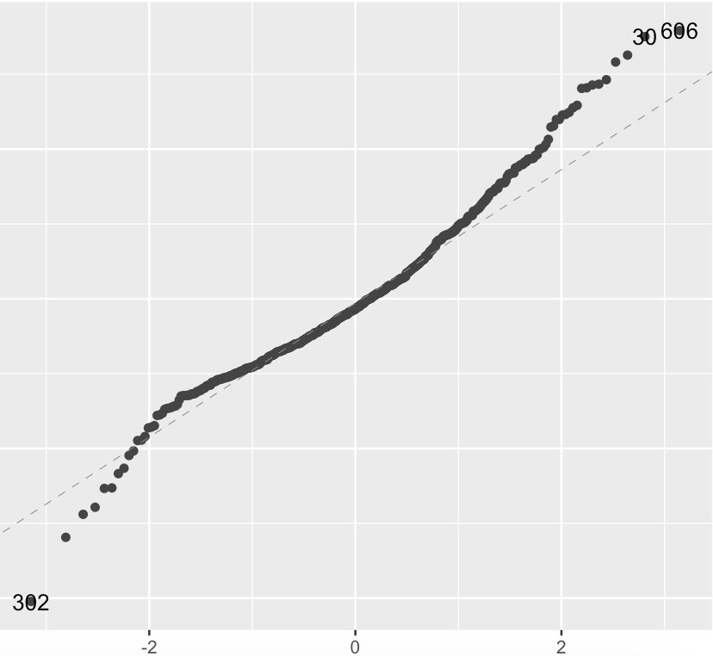

NORMALLY DISTRIBUTED ERRORS
qplot
Quantile-Quantile
Model Residuals
Theoretical Quantiles
Plotted residuals follow a normal distribution with the mean at 0.
Distribution of the residuals matches normal distribution.
Notes:
As we can see from the qplot that the plot of residuals follows a normal distribution with the mean at 0. Looking at the quantile-quantile graph, we can see that the points are almost completely on the line between the values of -1 to 1 on the x-axis, which confirms that the distribution of the residuals matches the normal distribution

Slide 33

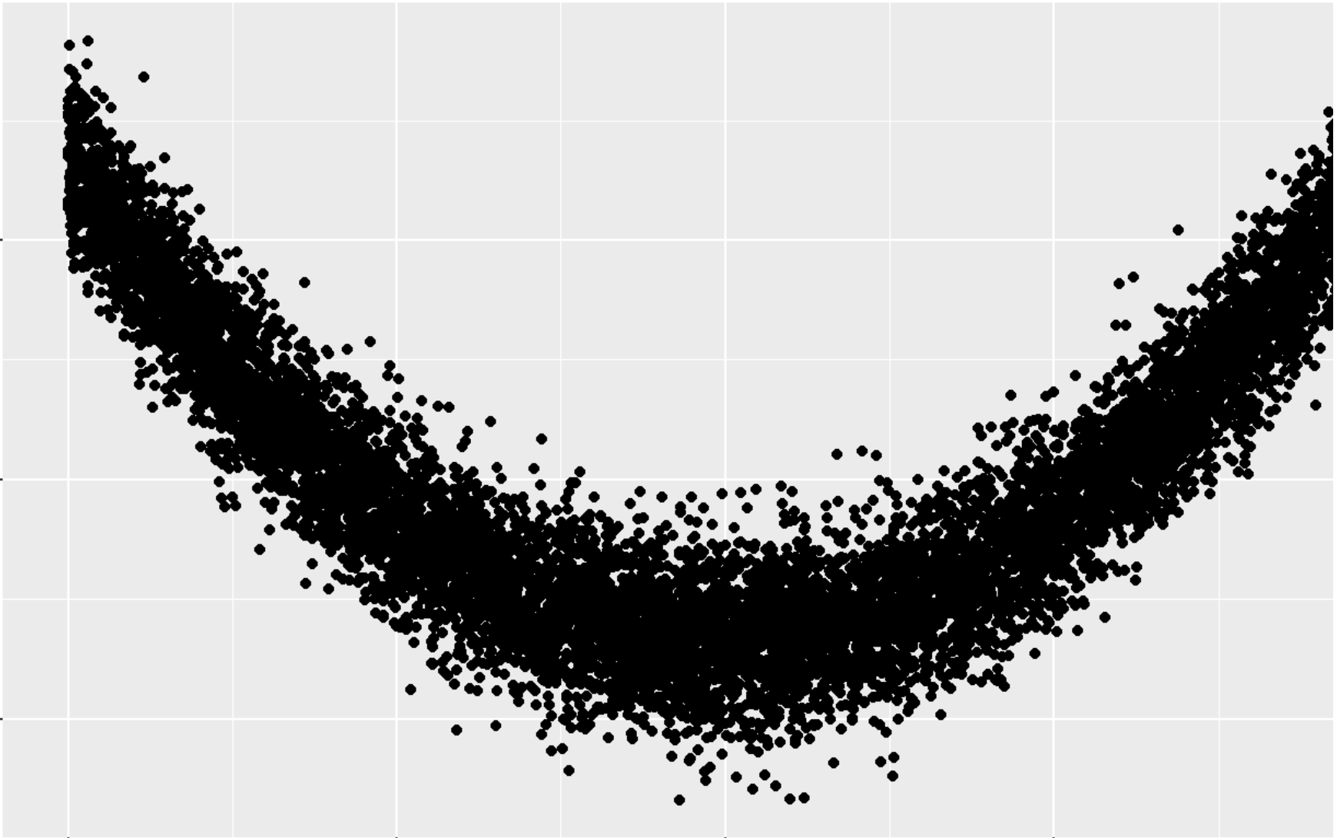
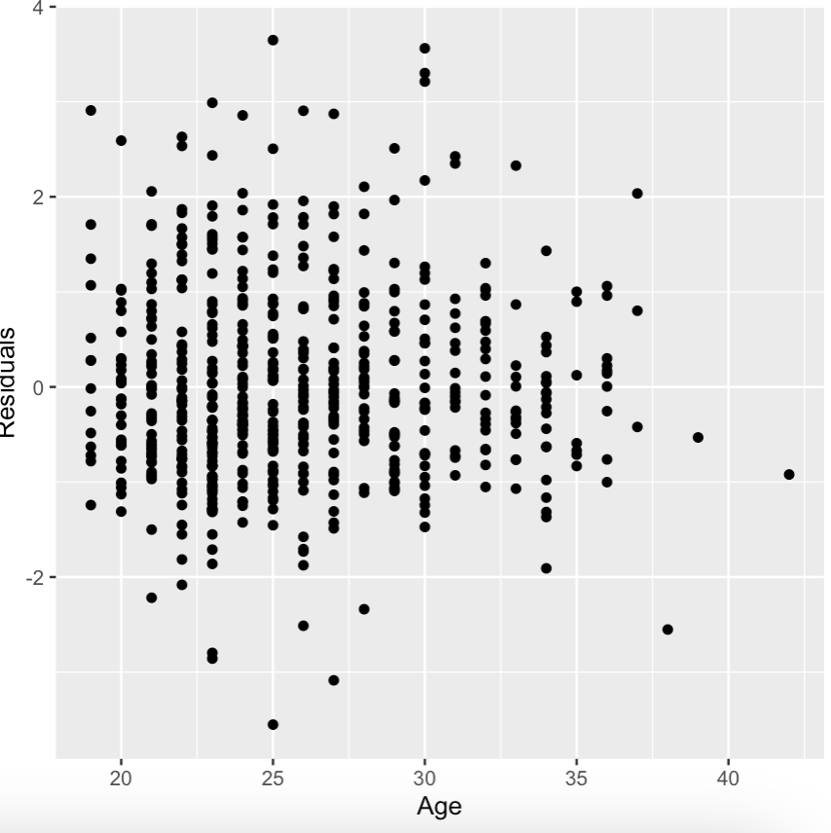
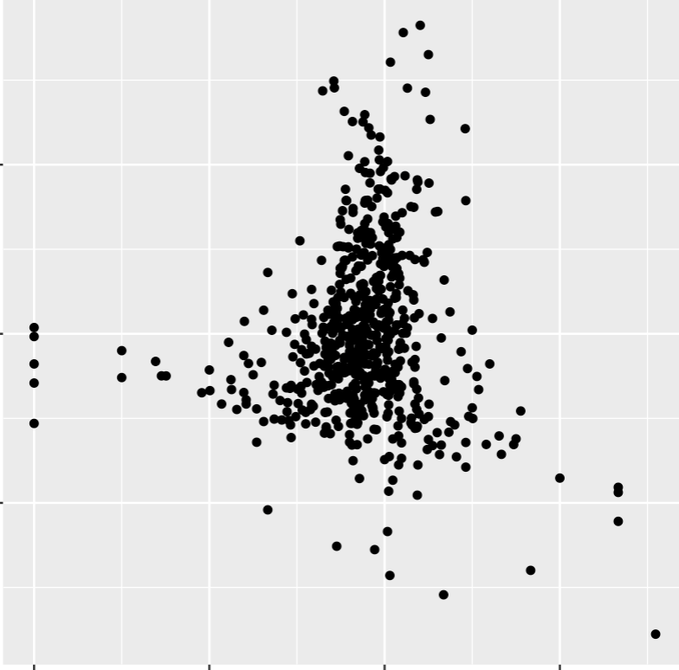
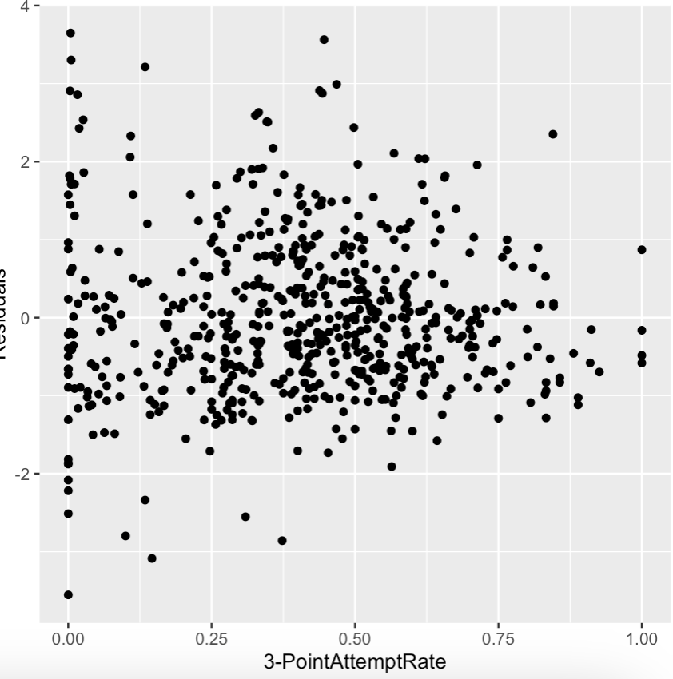
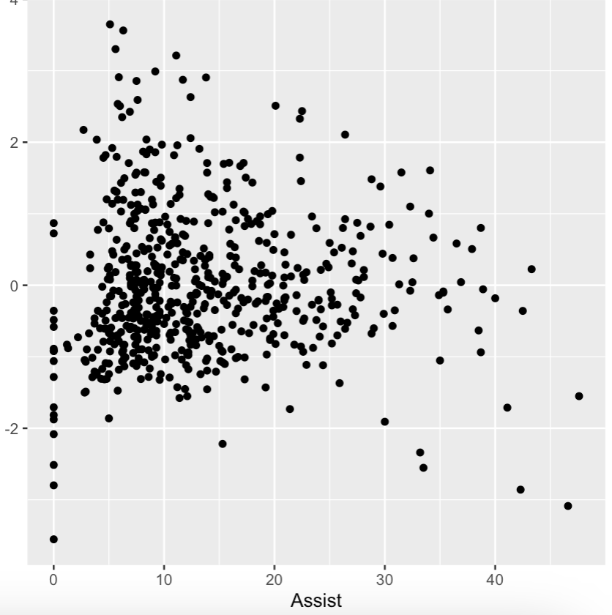
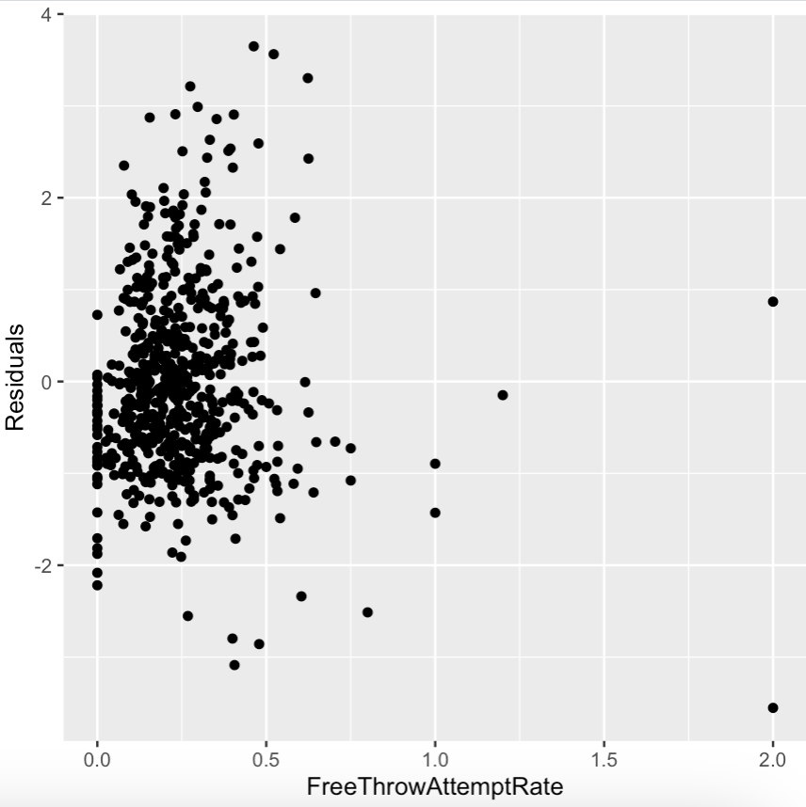
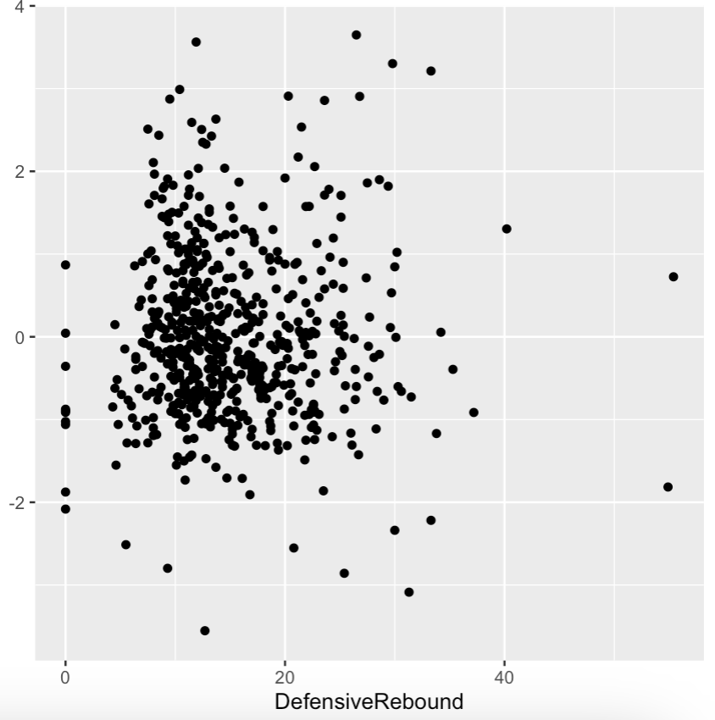
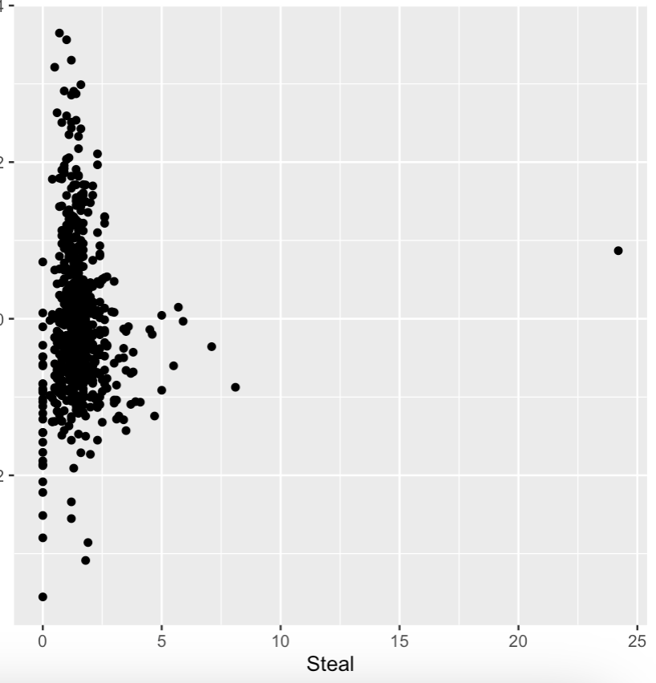
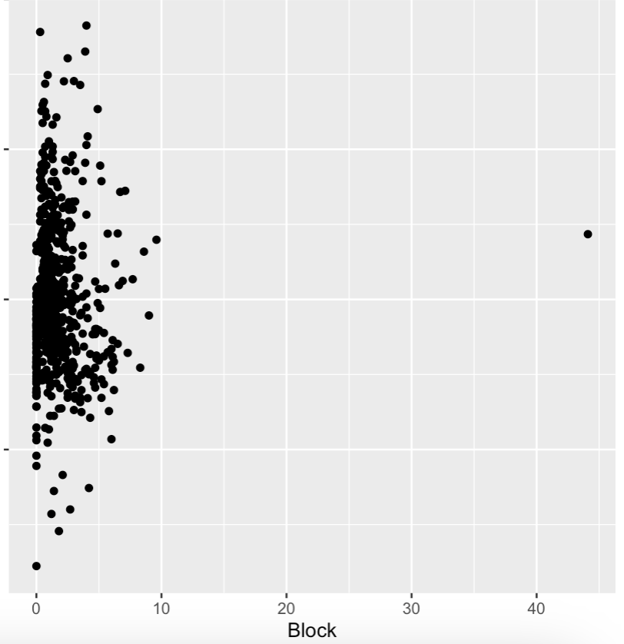
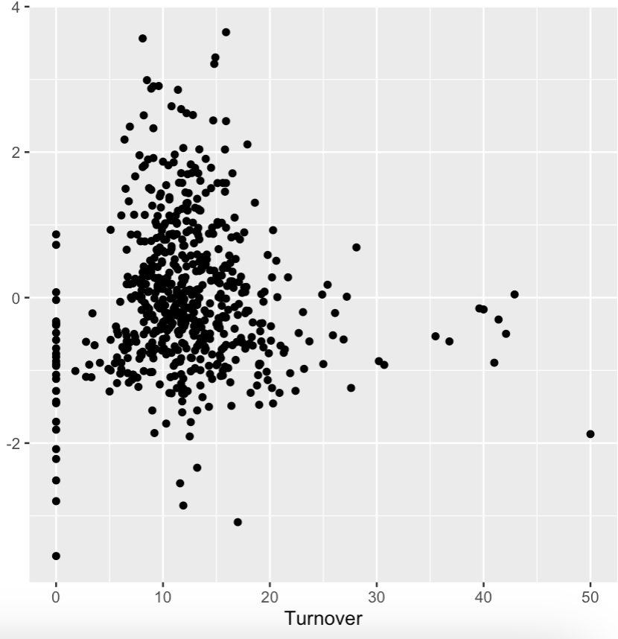
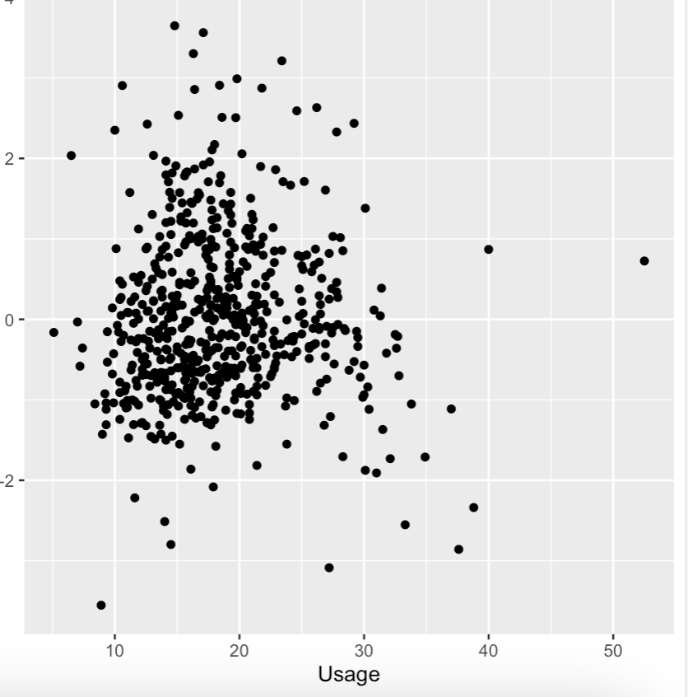
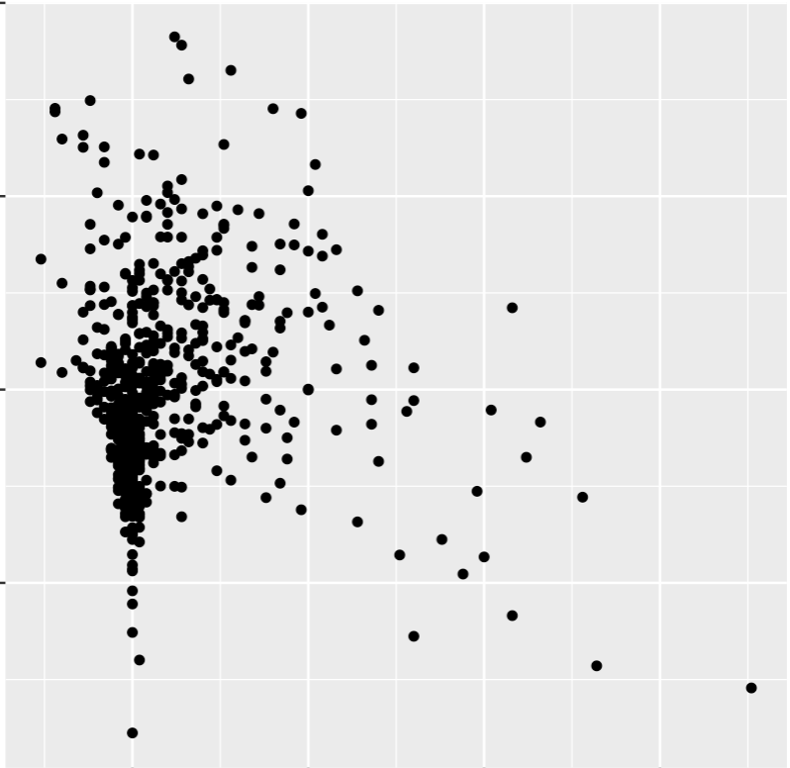
MODEL ACCURACY
Age
True Shooting %
3-Point Attempt Rate
 |  | 18
Free Throw Attempt Rate
Defensive Rebound
Assist
Steal
Block
Turnover
Usage
Value Over Replacement Player
Notes:
The image in the top left is just a visual reminder of what we do not want to see, as this would imply that the errors and predictors are correlated. The predictors here are the variables that our model chose to keep, and we can see that none of the predictors show a clear curvature. With that, we knew that we were still good to go with our model.

Slide 34
AIC VS. BIC
What AIC selected:
What BIC Selected:
Value over replacement player
Assist
True shooting %
Usage
3-Point Attempt Rate
Defensive Rebound
Steal
Turnover
Value over replacement player
Assist
True shooting %
Usage
3-point Attempt Rate
Notes:
Lastly, we applied the AIC and BIC selection techniques to see what each outputted. AIC removed 3 of the variables from our model, which were Age, Free Throw Attempt rate, and Block.
BIC further deducted defensive rebound, Steal, and turnover. But we knew we would wanted to utilize their output to better our model.

Slide 35
WHAT DID WE CHOOSE?
Why?
We decided to include variables in our final model that the BIC selection technique provided as we did not want to claim something is a predictor when it really is not.
BIC!
Notes:
So which one did we choose? BIC! Because we wanted to ensure we weren’t claiming something is a predictor when it really isn’t. Therefore, our final model that we used to predict the win share values is one that includes value over replacement player, 3-point attempt rate, assist, true shooting percentage, and usage.

Slide 36
RECAP: MODEL JOURNEY
Final Model
True Shooting %
3-Point Attempt Rate
Usage
Value over replacement player
Assist
Tests & BIC
Model 2
Applied vif function
Age
True Shooting %
3-Point Attempt Rate
Free Throw Attempt Rate
Defensive Rebound
Assist
Steal
Block
Turnover
Usage
Value over replacement player
1.449483 + 2.020618*Value Over Replacement Player + (-0.024489)*Assist + 1.651415*True Shooting Percentage + (-0.035903)*Usage + (-0.742261)*3-Point Attempt Rate
Model 1
Age
Games
Minutes Played
Player Efficiency Rating
True Shooting %
3-Point Attempt Rate
Free Throw Attempt Rate
Offensive Rebound
Defensive Rebound
Total Rebound
Assist
Value over replacement player
Usage
Steal
Block
Turnover
Box Plus/Minus
Notes:
To recap, our model was refined quite a bit. We first started with a model that we ran through a vif() function with, took that output and stored it as a new model which we performed further tests on and AIC/BIC to, and finished with a model that only has 4 of the 17 predictors we originally started with.

Slide 37

ACTUAL VS. PREDICTED
How did our model do?
We utilized Power BI to visualize the actual win share values per team and player vs the predicted win share values calculated by our model.

Slide 38

VISUAL DEMO
This visual shows the average win share value per team, which can be interactively adjusted to further show the player win share stats for a selected team.

Slide 39
Nikola Jokic
Blake Wesley
Max win share: 14.9
Value Over Replacement Player: 8.8
Assist: 46.6
True Shooting Percentage: 0.701
Usage: 27.2
3-Point Attempt Rate: 0.146
Min win share: -1.6
Value Over Replacement Player: -1.3
Assist : 18.8
True Shooting Percentage: 0.393
Usage: 18.5
3-Point Attempt Rate: 0.242
Notes:
Here we have the player with the max win share value and the player with the minimum win share value. These stats make sense with our model as for every increase in value over replacement player value, the win share value increases by 2, as it is the most heavily weighted predictor in our model. So, having a value over replacement player score of -1.3 decreases the win share value quite a bit, in comparison to other players.

Slide 40
FOLLOW UP QUESTION 3
Does a player’s position make a difference in their win share score?

Slide 41
Built a model
2. Applied vif()
3. Analyze
Created a separate model by adding player position to variables/predictors from previous final model
Applied the vif function to ensure no value greater than 5
What did the model suggest?

Slide 42
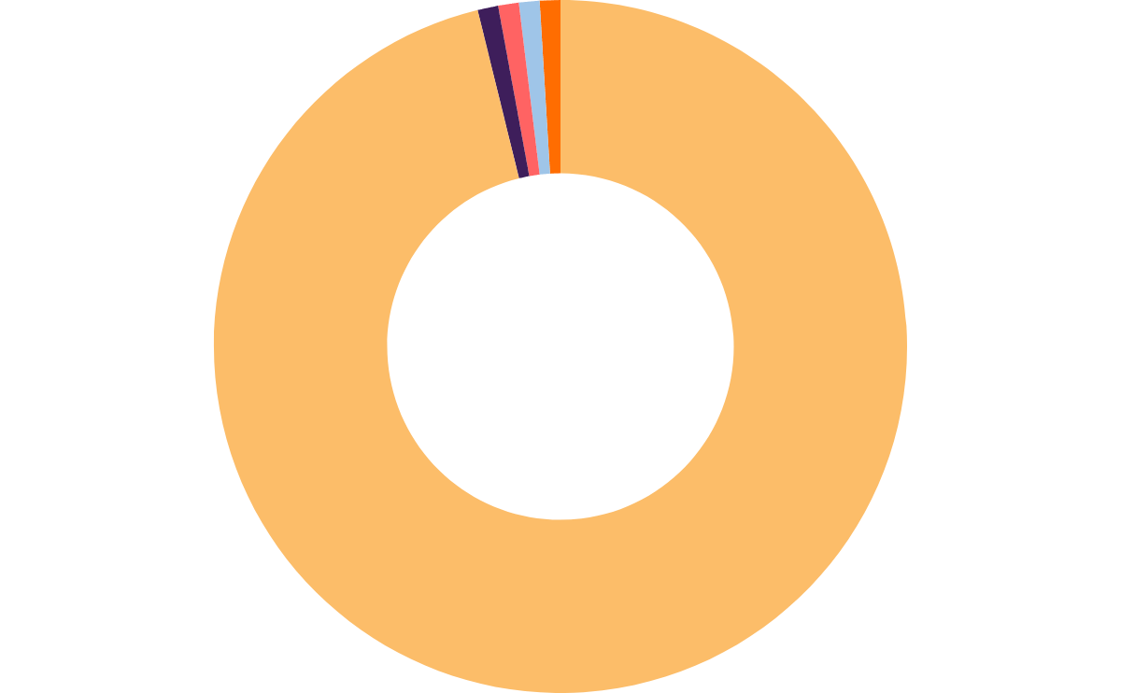
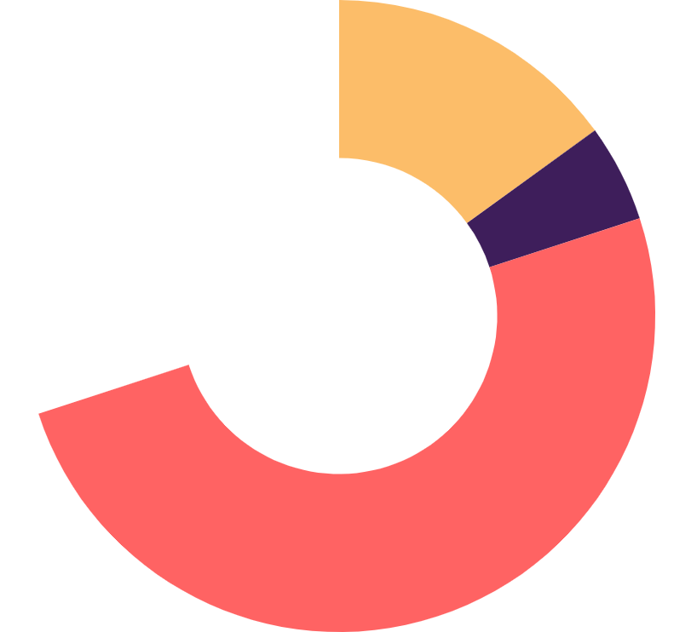
NOT SIGNIFICANT
15%
The p-value for all positions were below 0.05. Therefore, they are not statistically significant enough to make a difference in a player’s win share score
30%
5%
Other predictors
Position PF
Position PG
50%
Position SF
Position SG
Approximate weight of p-value scores

Slide 43
Questions?

